Slide 1
Cloud Computing, SAP Business Technology Platform (BTP) and SAP Integration Suite Overview
September 2023

Slide 2
Agenda
Introduction to Cloud Computing
Cloud Computing Advantages
Cloud Computing Services
SAP Business Technology Platform (BTP) Overview
SAP Business Technology Platform (BTP) Capabilities
SAP Integration Suite Overview
SAP Integration Suite Capabilities
SAP Integration Suite Pricing Models
References

Slide 3
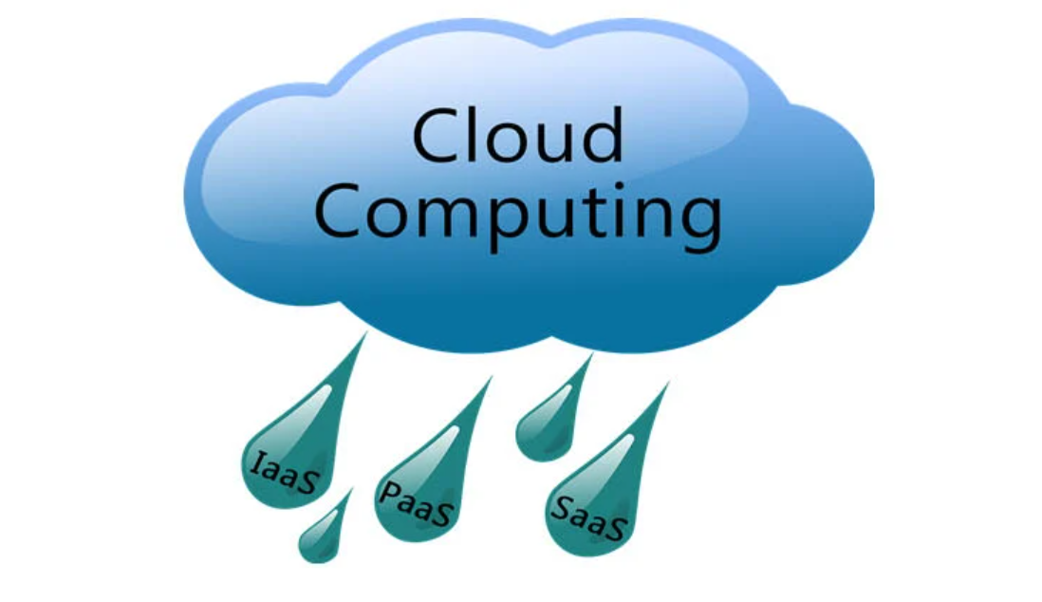
Introduction to Cloud Computing
Cloud Computing is the concept of delivering computing services and resources over the Internet.
We broadly categorize computing services as applications, data, runtime, middleware, OS, virtualization, servers, storage and networking. If one or more of these services are delivered via the Internet, we call it as cloud computing.

Slide 4
Cloud Computing : Advantages
Availability: You can access your solutions and services anytime from anywhere with any device. The same cannot be said for traditional computing.
Cost-effectiveness: Cloud computing allows organizations to avoid high costs of network implementation and hardware purchases. Additionally, you only pay for what you use which reduces IT costs.
Scalability: You can easily scale up or scale down your services and requirements in a shorter time period than traditional computing. Moreover, the scaling up can be done with minimum IT costs and capital costs for hardware purchases.
Simplicity: Another great advantage of cloud computing is the simplicity of use. Your IT team requires less effort when it comes to system updates, upgrades, and general maintenance.

Slide 5
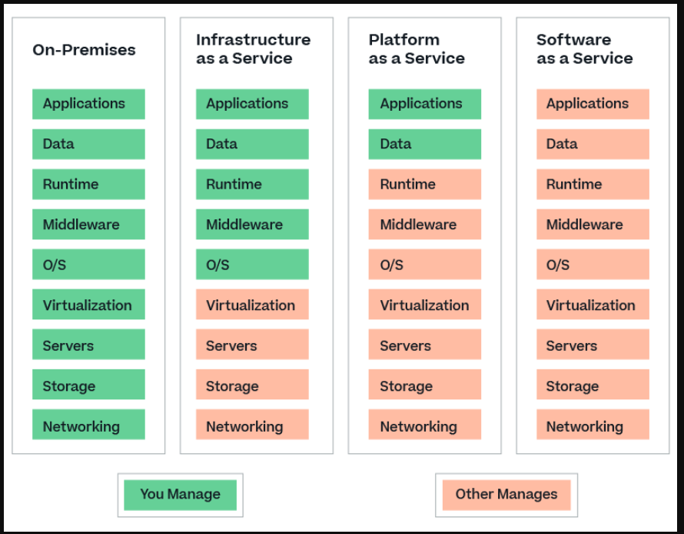
Cloud Computing : Services

Slide 6
Cloud Services : Software-as-a-service (SaaS)
The main characteristic of SaaS is that the software is hosted centrally and delivered over the Internet. Users access the hosted applications through web browsers, cell phones, tablets, etc. As you can see from the previous slide, cloud application providers manage the application/data and underline infrastructure.
Customers can usually access these hosted applications on a subscription basis.
Some of the SaaS Offering's from SAP
SAP SuccessFactors
SAP Ariba
SAP Analytics Cloud
SAP Concur
SAP Business One Cloud

Slide 7
Cloud Services : Platform-as-a-Service (PaaS)
Platform-as-a-service refers to cloud environments that allow the development, testing, deployment, and management of applications. Developers can build custom applications without having to manage the underline infrastructure, such as servers and networks.
However, customers should manage the applications built on the platform, including their data.
The cloud resources are deployed and managed by cloud service providers while end-users have the liberty to use the service on a pay-per-use basis.
Some of the widely used PaaS offerings in the world are SAP Integration Suite, Google App Engine, Red Hat OpenShift, and GitHub.
SAP Integration Suite is an integration platform-as-a-service (iPaaS) offered by SAP. In Integration Suite, developers can build, test, monitor, and manage integration scenarios. Since it is integration-specific, the product belongs to a subcategory of PaaS called iPaaS, which stands for integration platform-as-a-service.

Slide 8
Cloud Services : Infrastructure-as-a-Service (IaaS)
IaaS provides access to computing resources in a virtualized environment “the cloud” on internet. It provides computing infrastructure like virtual server space, network connections, bandwidth, load balancers and IP addresses on a pay-as-you-go basis.
The pool of hardware resource is extracted from multiple servers and networks usually distributed across numerous data centers. This provides redundancy and reliability to IaaS.
SAP Hana Enterprise Cloud (HEC) is SAP’s proprietary IaaS product. Amazon Web Services (AWS), Cisco Metapod, Microsoft Azure, Google Compute Engine (GCE) are some of the other IaaS solutions available worldwide.

Slide 9
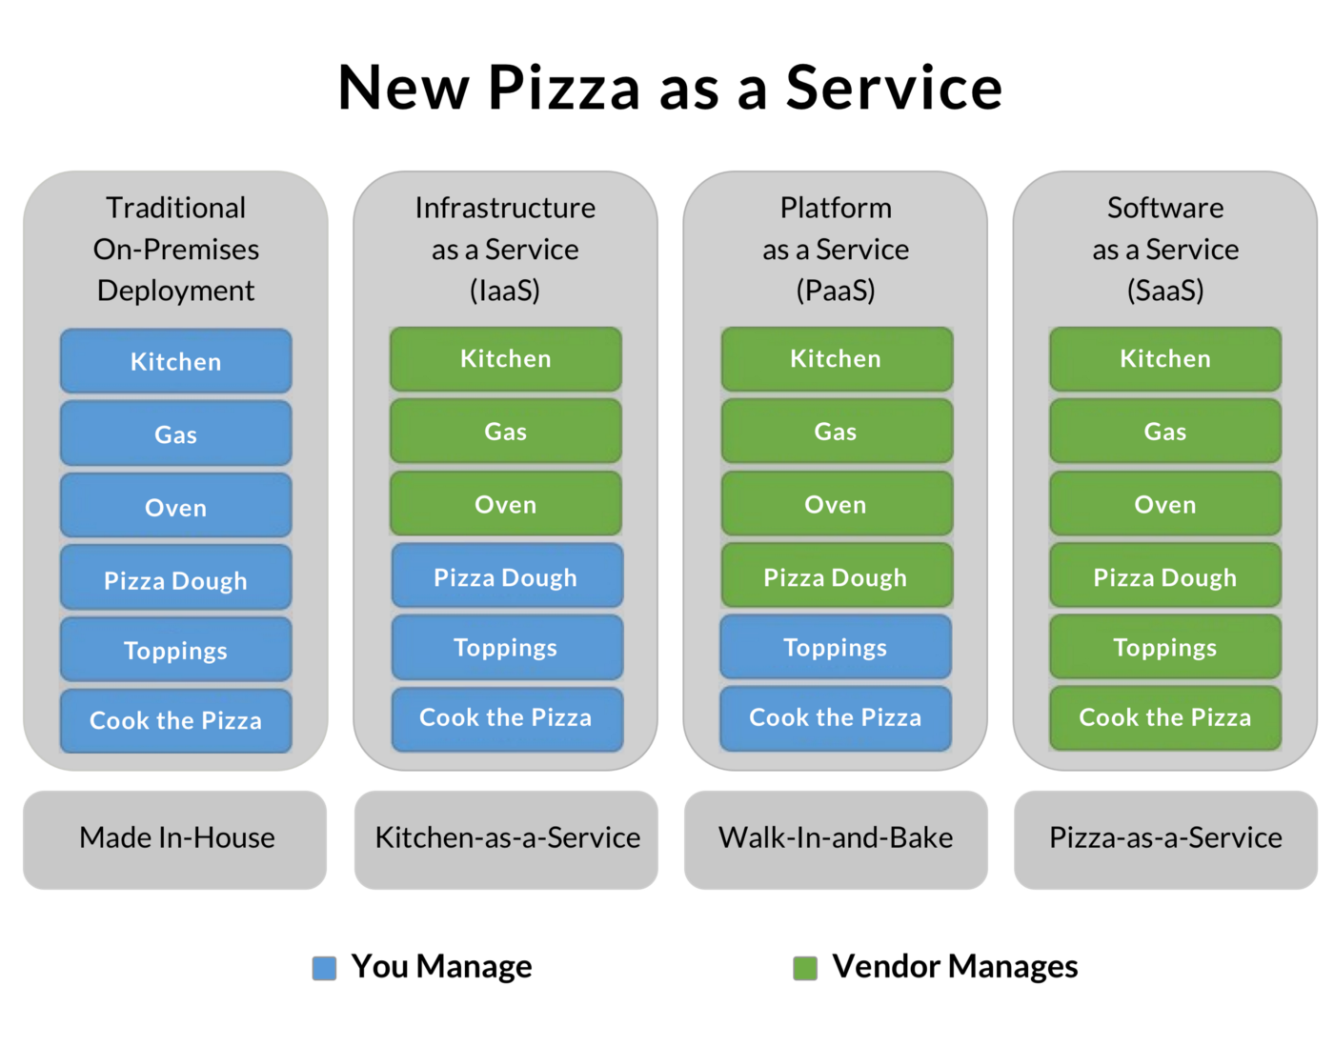
Cloud Services : Use Case

Slide 10
SAP Business Technology Platform (BTP)
SAP Business Technology Platform (SAP BTP) takes SAP’s products, services, and solutions, and puts them under one roof.
It’s not a tool or a system in and of itself, but instead a collection of on-premise and cloud products that can be grouped under four pillars
SAP's open platform as a service for developing cloud business applications in a fully provisioned environment. Using a set of end-to-end services, capabilities, and tools, developers can build, extend, and integrate business applications in the cloud.
SAP BTP encompasses various capabilities that can be categorized into four pillars:
Database and Data management
Analytics
Application Development and integration
Intelligent Technologies

Slide 11
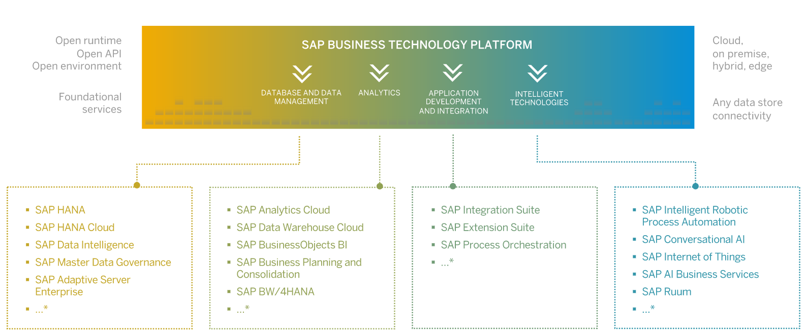
SAP Business Technology Platform (BTP) Capabilities

Slide 12
SAP Integration Suite
SAP Integration Suite is an integration platform as a service (iPaaS) that allows you to smoothly integrate on-premise and cloud-based applications and processes with tools and prebuilt content managed by SAP.
We can Develop and manage enterprise-wide integration across heterogeneous landscapes.
Pre-built integration packs along with existing investments can be composed to deliver new outcomes with less involvement by integration experts.

Slide 13
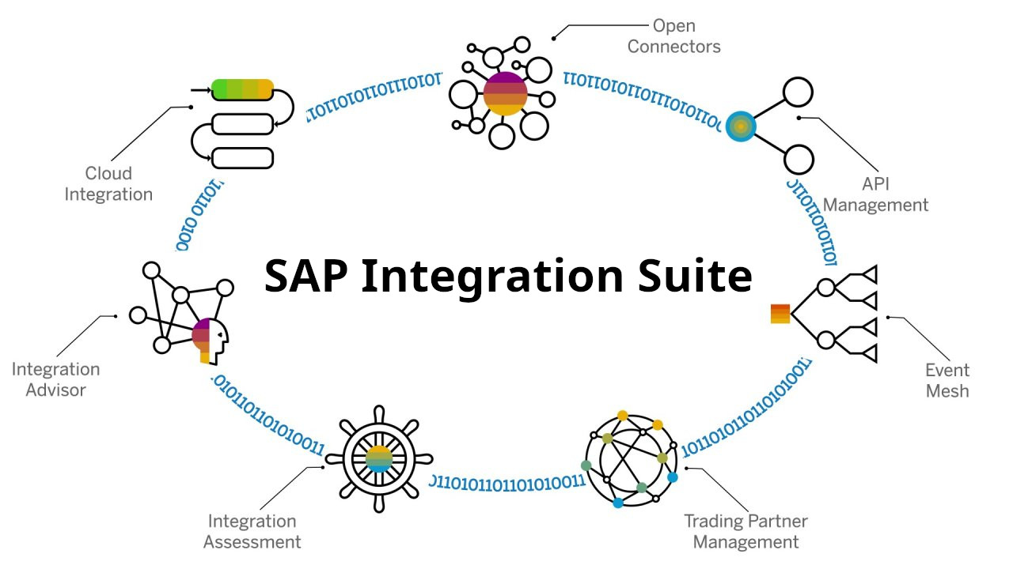
SAP Integration Suite Capabilities

Slide 14
SAP Integration Suite: Open Connectors
Simplify connectivity to more than 170 third-party applications and solutions for collaboration, messaging, CRM, help desk, and other application types.
Use prebuilt connectors to simplify, standardize, and accelerate connectivity with third-party cloud applications
Take advantage of open RESTful APIs and JSON data format, regardless of underlying third-party service architecture
Apply common resource definitions to transform data fields from one or more third-party applications into a normalized form
Support bulk data upload and download data in a normalized way, regardless of the underlying service architecture

Slide 15
SAP Integration Suite: API Management
Create simple, connected digital experiences for your consumers, partners, and employees and unlock new opportunities and business potential in the API economy by exposing processes and data as APIs through their complete end-to-end lifecycle in an enterprise API portal.
Design your APIs based on open standards, including OData and the Open API specification
Develop your APIs by exposing and composing back-end interfaces from apps or middleware
Protect your APIs from security threats, manage traffic, and cache your data on the edge with more than 40 built-in policies
Monitor and analyze API usage, performance, and errors
Engage with application developers and monetize your digital assets through API portals

Slide 16
SAP Integration Suite: Event Mesh
SAP Event Mesh, a cloud-based capability, allows applications to communicate through asynchronous events, and extend your digital core. Intelligent enterprises use SAP Event Mesh to trigger process integration with one or more related applications.
Respond natively to business events from core SAP solutions, like SAP S/4HANA and SAP SuccessFactors solutions, or third-party sources
Publish and subscribe to business events from SAP and third-party sources across hybrid, multi-cloud, and edge environments
Manage, monitor, and visualize decentralized event streaming across distributed landscapes.

Slide 17
SAP Integration Suite: Trading Partner and Management
Create and maintain trading partner profiles with their unique B2B requirements.
Simplify B2B integration scenario management with multiple trading partners
Accelerate onboarding of trading partners
Create trading partner agreements that define the choreography of business transactions
Monitor integrations with business partners
Exchange business data with trading partners with the Integration Advisor and Cloud Integration capabilities

Slide 18
SAP Integration Suite: Integration Assessment
Apply a systematic and guided approach to the design and execution of your enterprise integration strategy.
Simplify integration with a systematic integration approach
Leverage the latest SAP integration technology recommendations
Document your integration landscape and integration technology strategy to improve communication between project teams and systems integrators
React faster to new interface requests or change requests
Establish integration as a recognized discipline within an organization and leverage it as a competitive differentiator

Slide 19
SAP Integration Suite: Integration Advisor
A crowdsourced machine learning approach to solve the biggest problems you face in B2B, A2A, and B2G integration scenarios.
Support multiple business partners using different industry-standard message formats
Save implementation time by starting with a library of prebuilt industry-standard message type definitions
Define and document source and target message implementation guidelines based on industry and geographic context
Simplify the creation of the message mapping artifacts by taking advantage of the AI-powered mapping proposals

Slide 20
SAP Integration Suite: Cloud Integration (CI)
Build and run application-to-application (A2A), business-to-business (B2B), and business-to-government (B2G) integration flows and support end-to-end process integration through the exchange of messages between applications, whether on premise, in the cloud, or across hybrid landscapes.
Leverage over 2,500 prebuilt integrations
Simplify integration between SAP and third-party applications and data source
Intuitive AI-assisted Web interface.
Design and manage integration flows quickly and easily.

Slide 21
SAP Integration Suite Pricing Models
SAP provides 3 types of Service Plans for Integration Suite.
Cloud Platform Enterprise Agreement (CPEA): Service plans for CPEA (Cloud Platform Enterprise Agreement) is a consumption based commercial model.
Standard Edition: 1 Tenant + 10K Bundled Messages (per month) .
Messages: Transactions (10K messages per block). Billing will be calculated based on the number of messages using Price Slab.
Pay As you Go (PAYGO) :
Service plans for PAYGO (Pay-As-You-Go is a consumption based commercial model)
Standard Edition: 1 Tenant + 10K Bundled Messages (per month) .
Messages: Transactions (10K messages per block). Billing will be calculated based on the number of messages using Price Slab.
Subscription:
Service plans for Subscription (A subscription allows access to cloud service up to a licensed maximum, independent of actual usage).
Standard Edition:1 Tenant + 10K Bundled Messages (per month)
Premium Edition: 4 Tenants + 10M Bundled Messages (per month)
Messages: Transactions (10K messages per block). Billing will be calculated based on the number of messages using Price Slab.

Slide 22
References
https://help.sap.com/docs/SAP_CLOUD_PLATFORM_INTEGRATION_SUITE/51ab953548be4459bfe8539ecaeee98d/5cc6987511104c418b7cb4c25f3d9cb0.html
https://learning.sap.com/learning-journey/developing-with-sap-integration-suite
https://help.sap.com/learning-journeys/500a46f27a261014ba6a9420b00213f1
https://help.sap.com/docs/BTP
https://community.sap.com/topics/business-technology-platform
https://community.sap.com/search/?ct=blog&q=integration+suite
https://help.sap.com/learning-journeys/ec5aa55abb8c4970bc3b07efe2253cfb
https://www.sap.com/products/technology-platform/integration-suite/capabilities.html#cloud-integration

Slide 23

About Deloitte Deloitte refers to one or more of Deloitte Touche Tohmatsu Limited, a UK private company limited by guarantee, and its network of member firms, each of which is a legally separate and independent entity. Please see www.deloitte.com/about for a detailed description of the legal structure of Deloitte Touche Tohmatsu Limited and its member firms. Please see www.deloitte.com/us/about for a detailed description of the legal structure of Deloitte LLP and its subsidiaries. Certain services may not be available to attest clients under the rules and regulations of public accounting. Copyright © 2013 Deloitte Development LLC. All rights reserved. 36 USC 220506 Member of Deloitte Touche Tohmatsu Limited
Notes:
22

